Slide 1
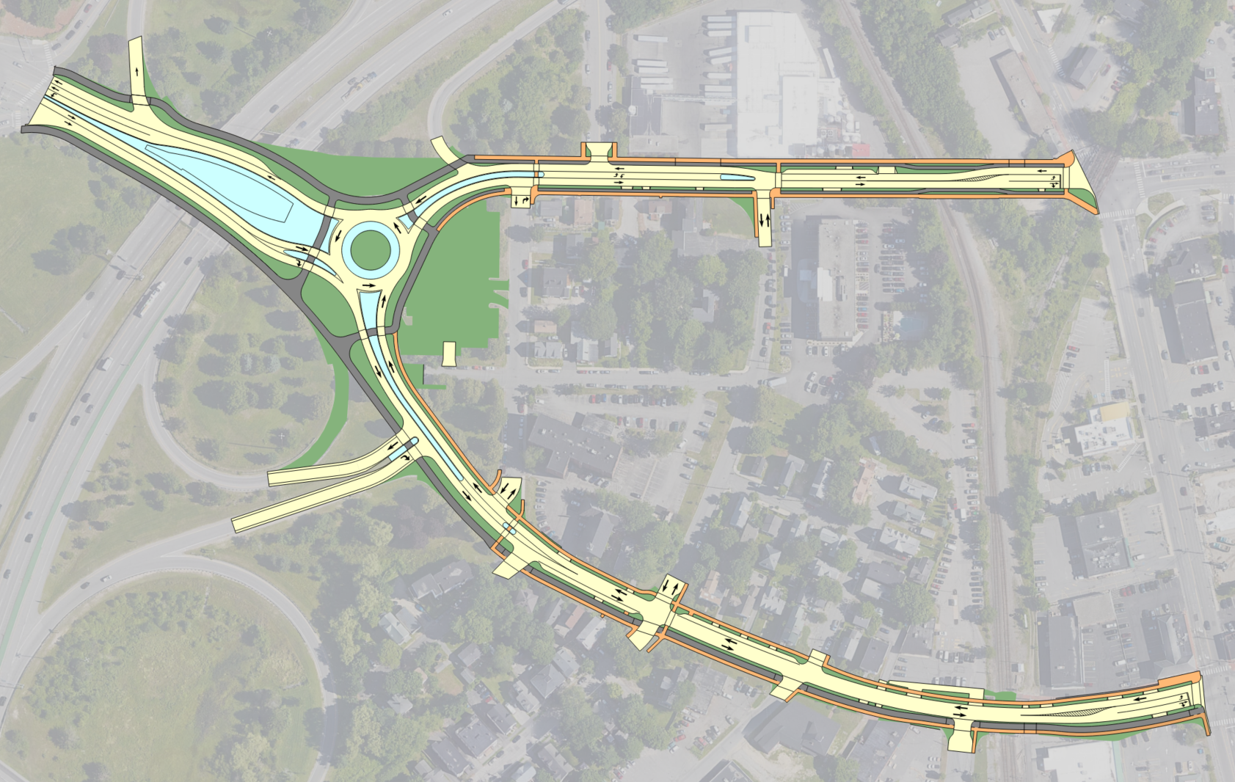

Reconnecting our villages: historic libbytown project improvement
preliminary public meeting - October 17th, 2024
Park Ave
Congress St
I-295
St John St
Congress St
MaineDOT
WIN # 026055.00

Slide 2
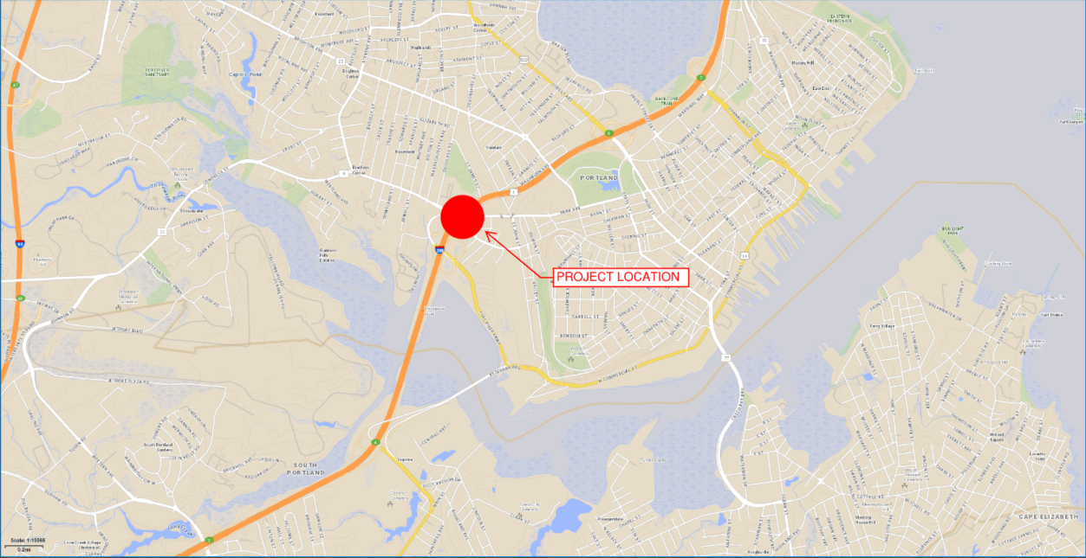
PROJECT LOCATION

Slide 3
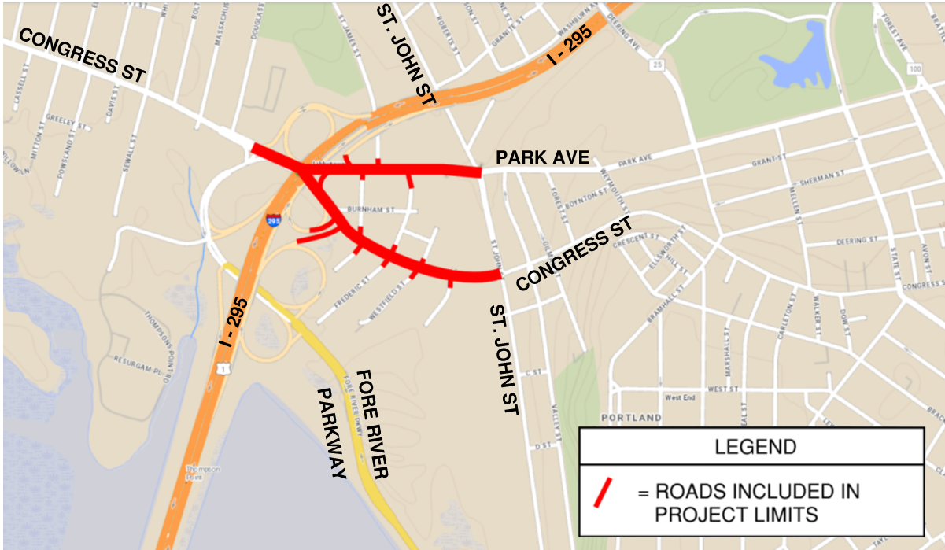
Project LIMITS

Slide 4
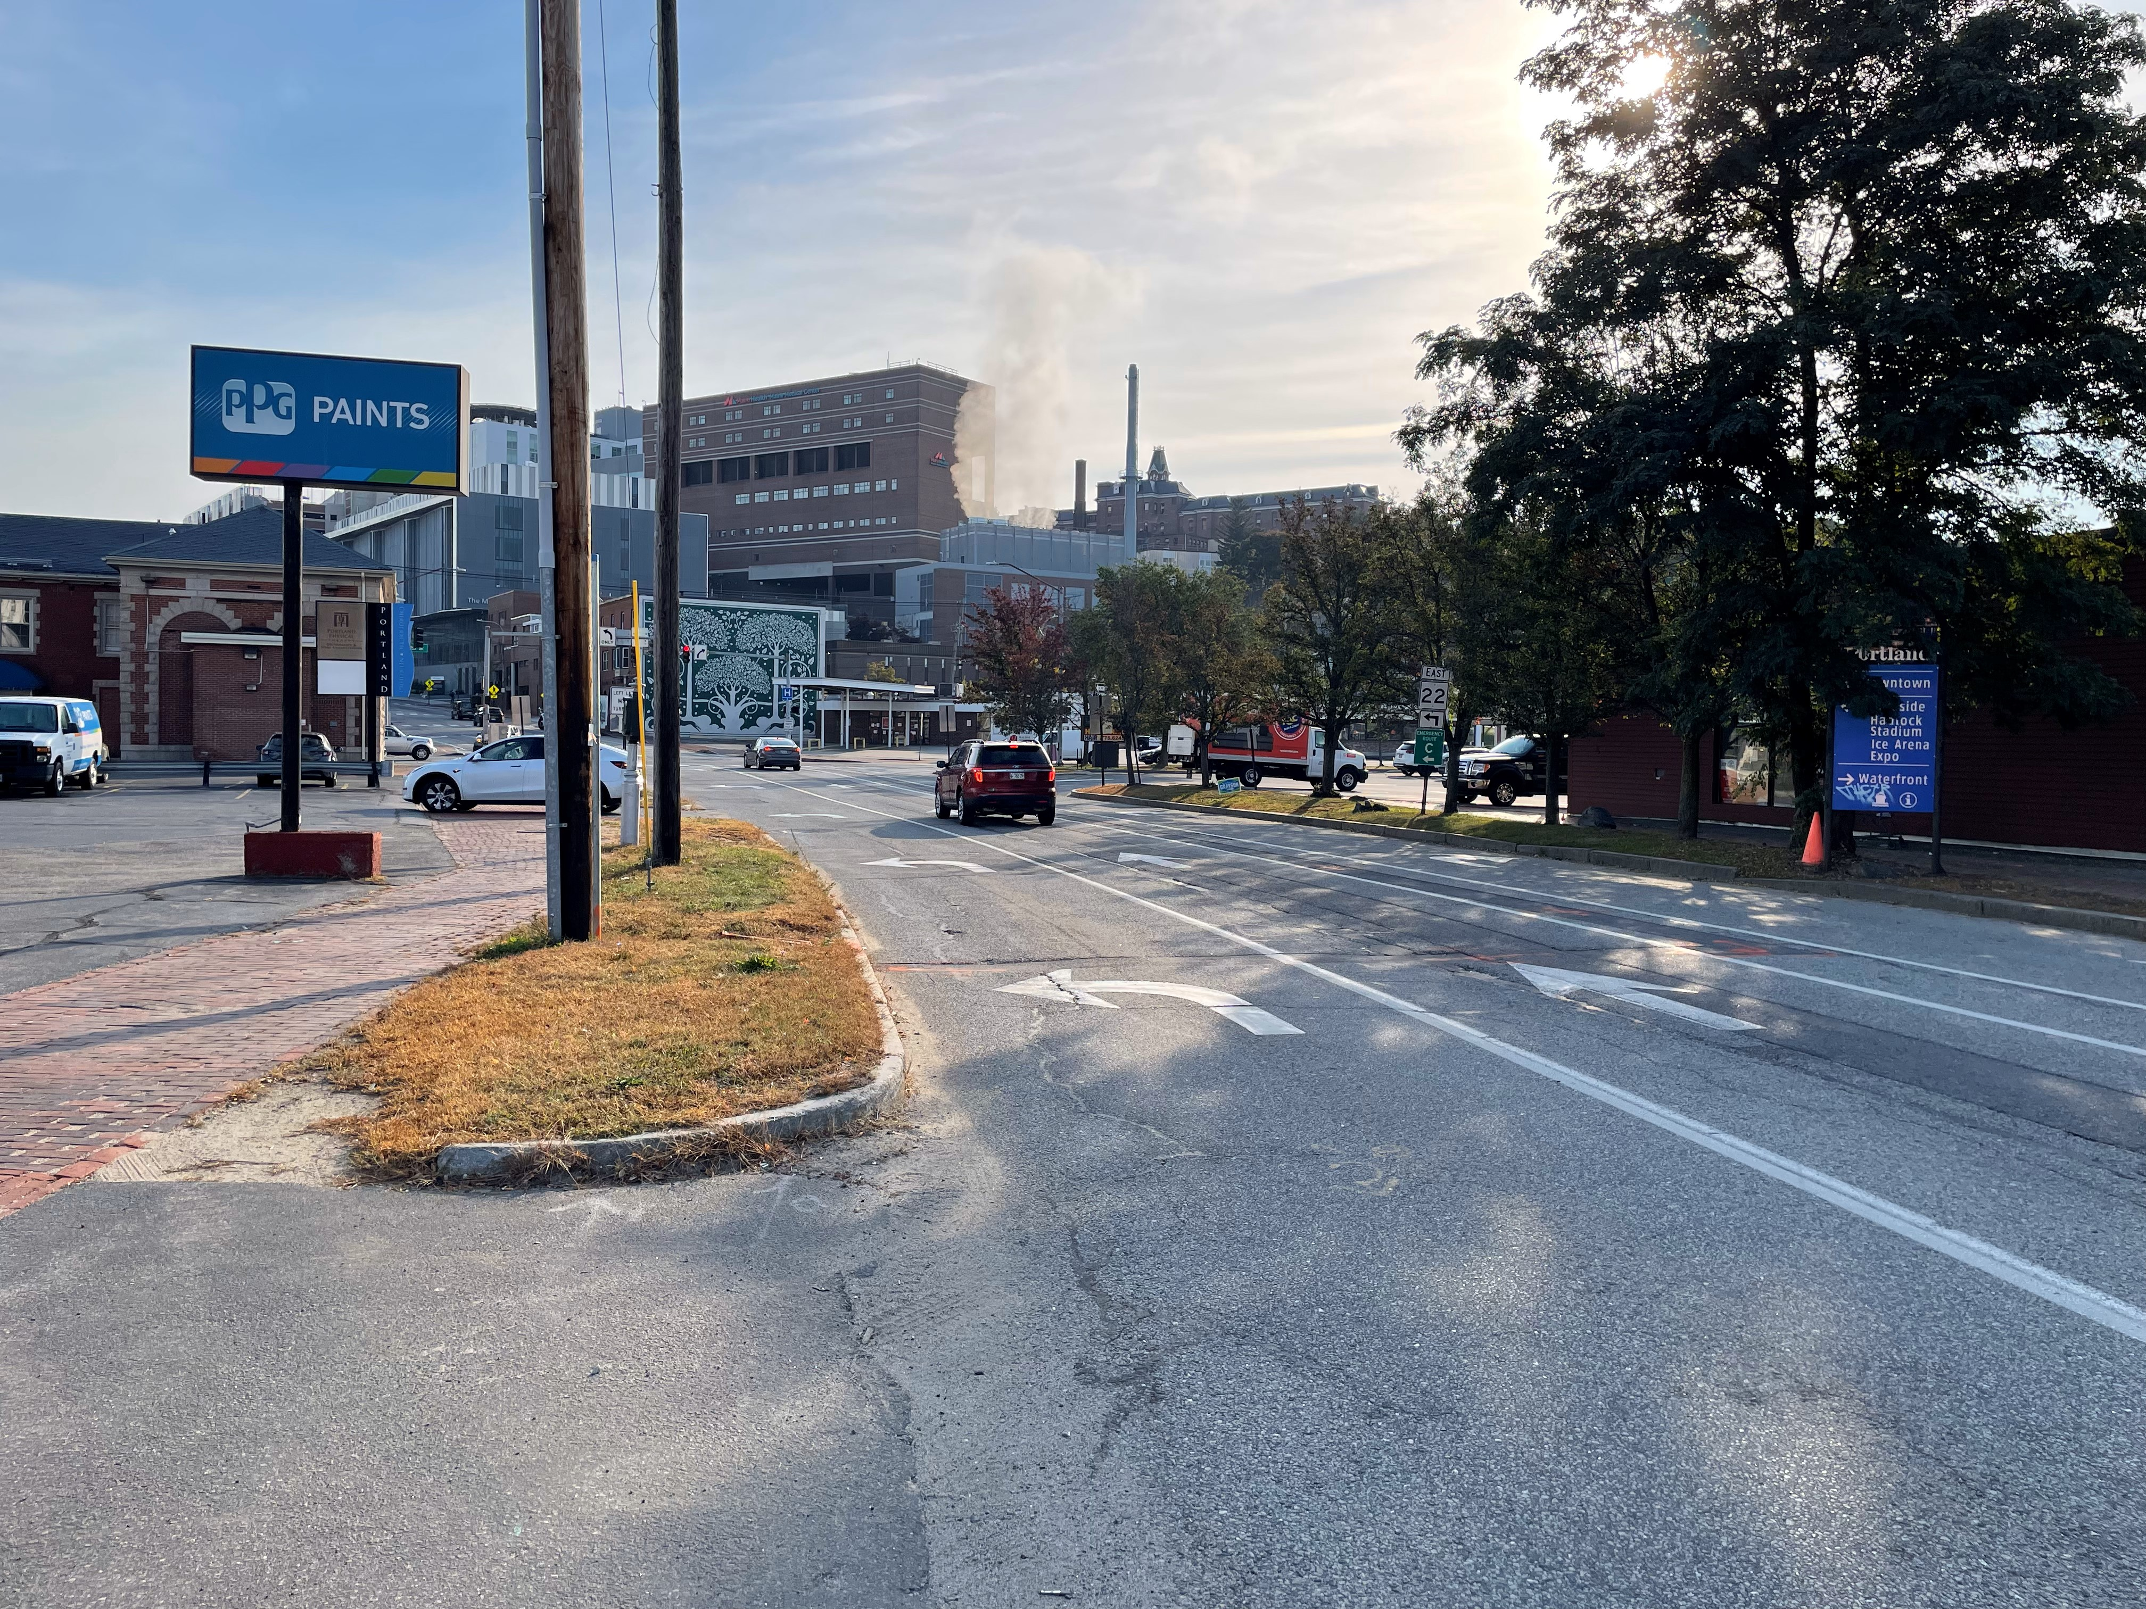
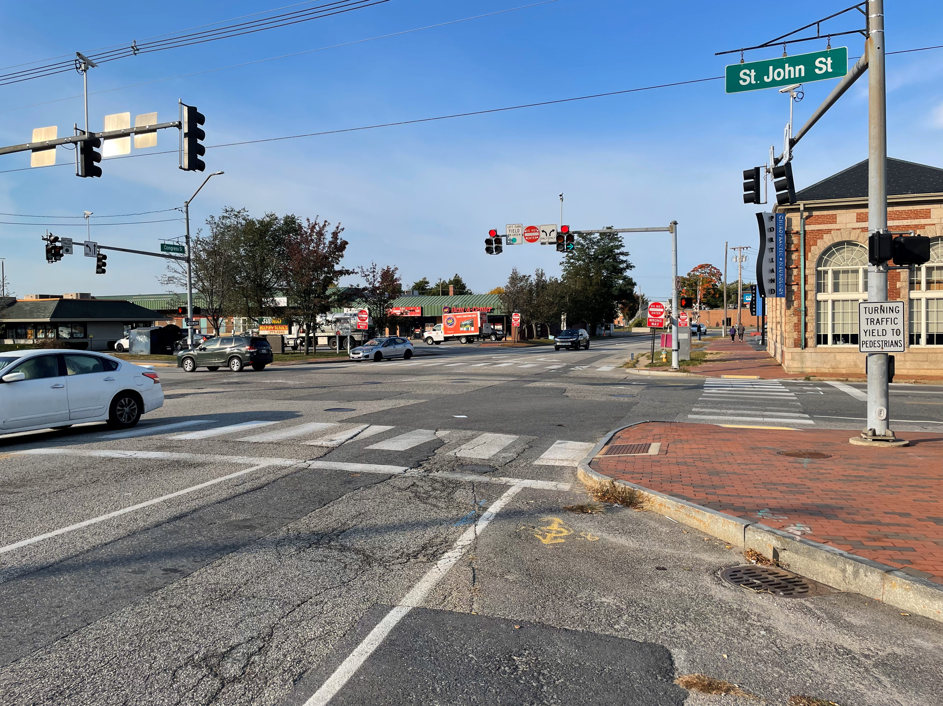
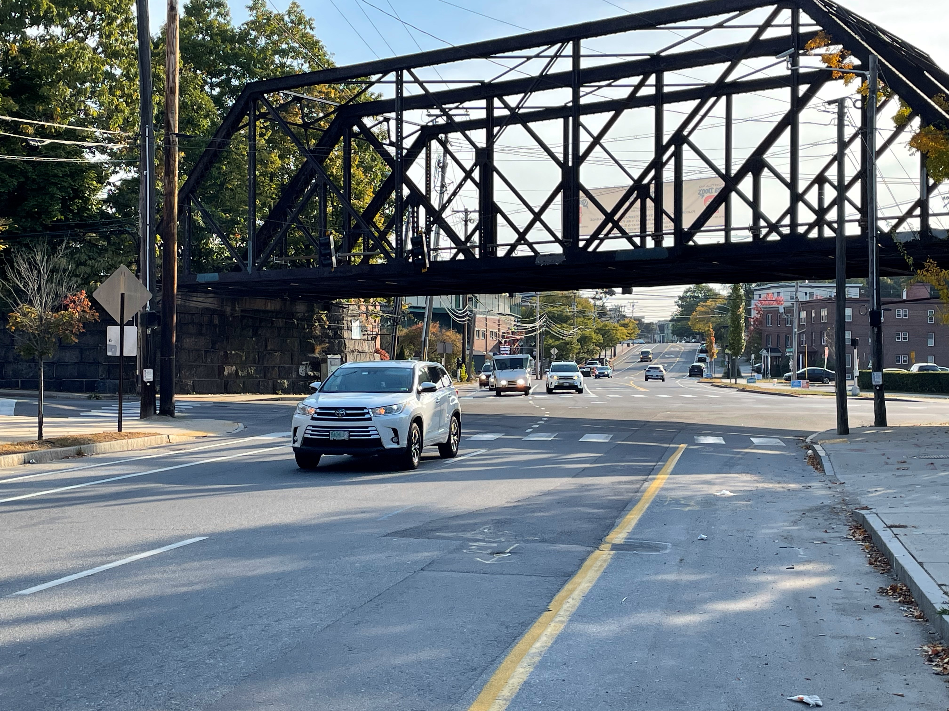
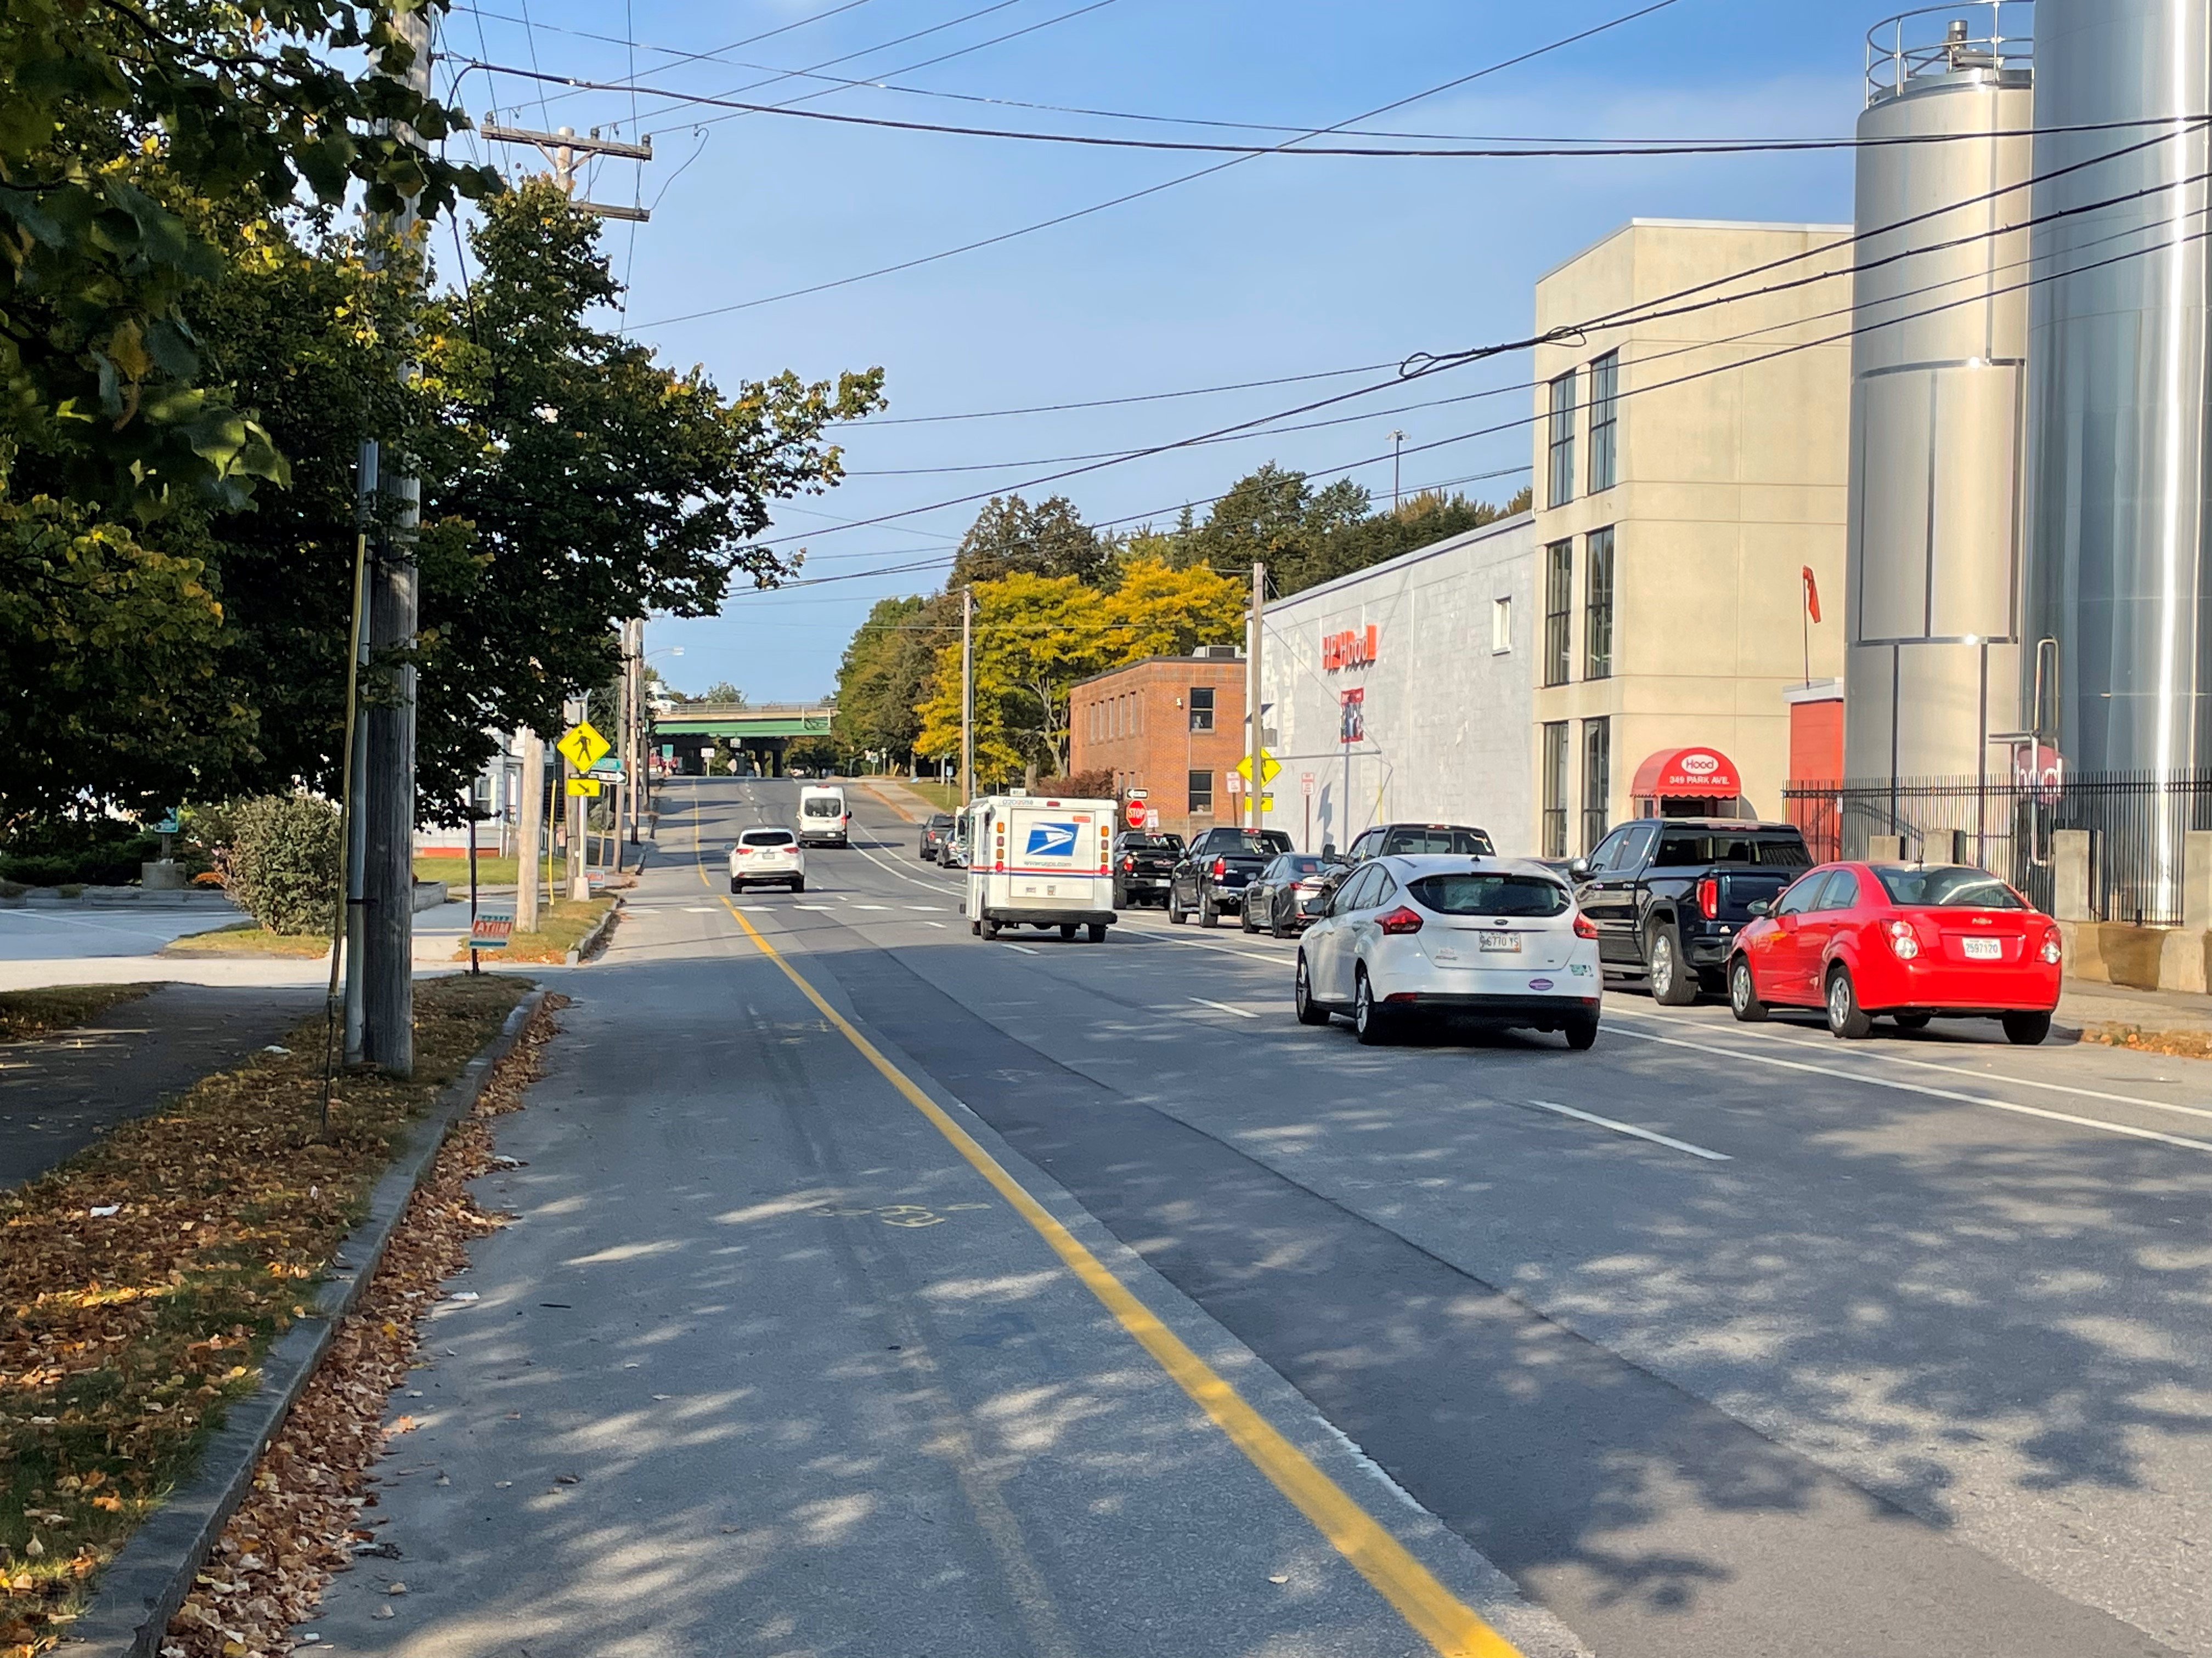
Existing Conditions
Congress St/St. John St Intersection, Facing East
Congress St/St. John St Intersection, Facing West
Park Ave/St. John St Intersection
Park Ave by HP Hood Factory

Slide 5
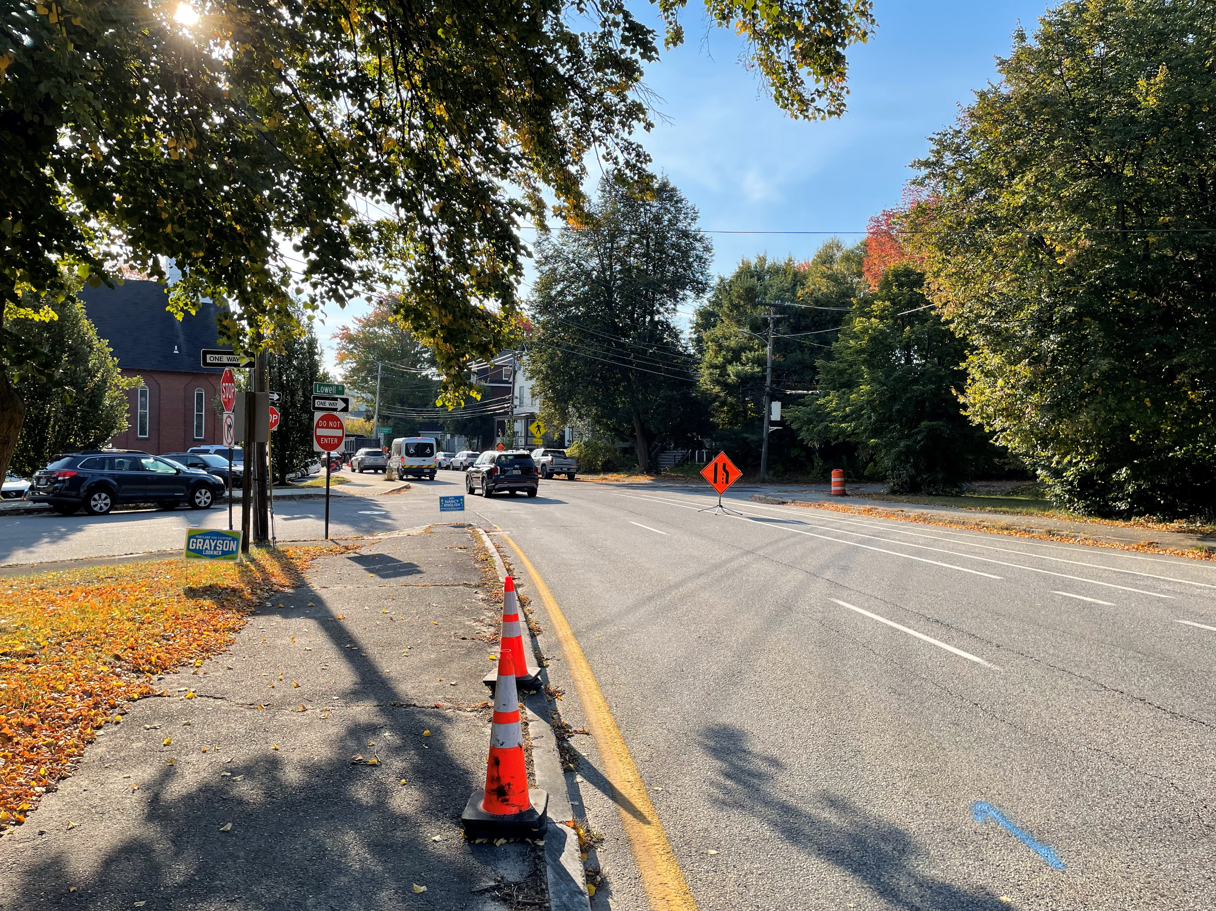
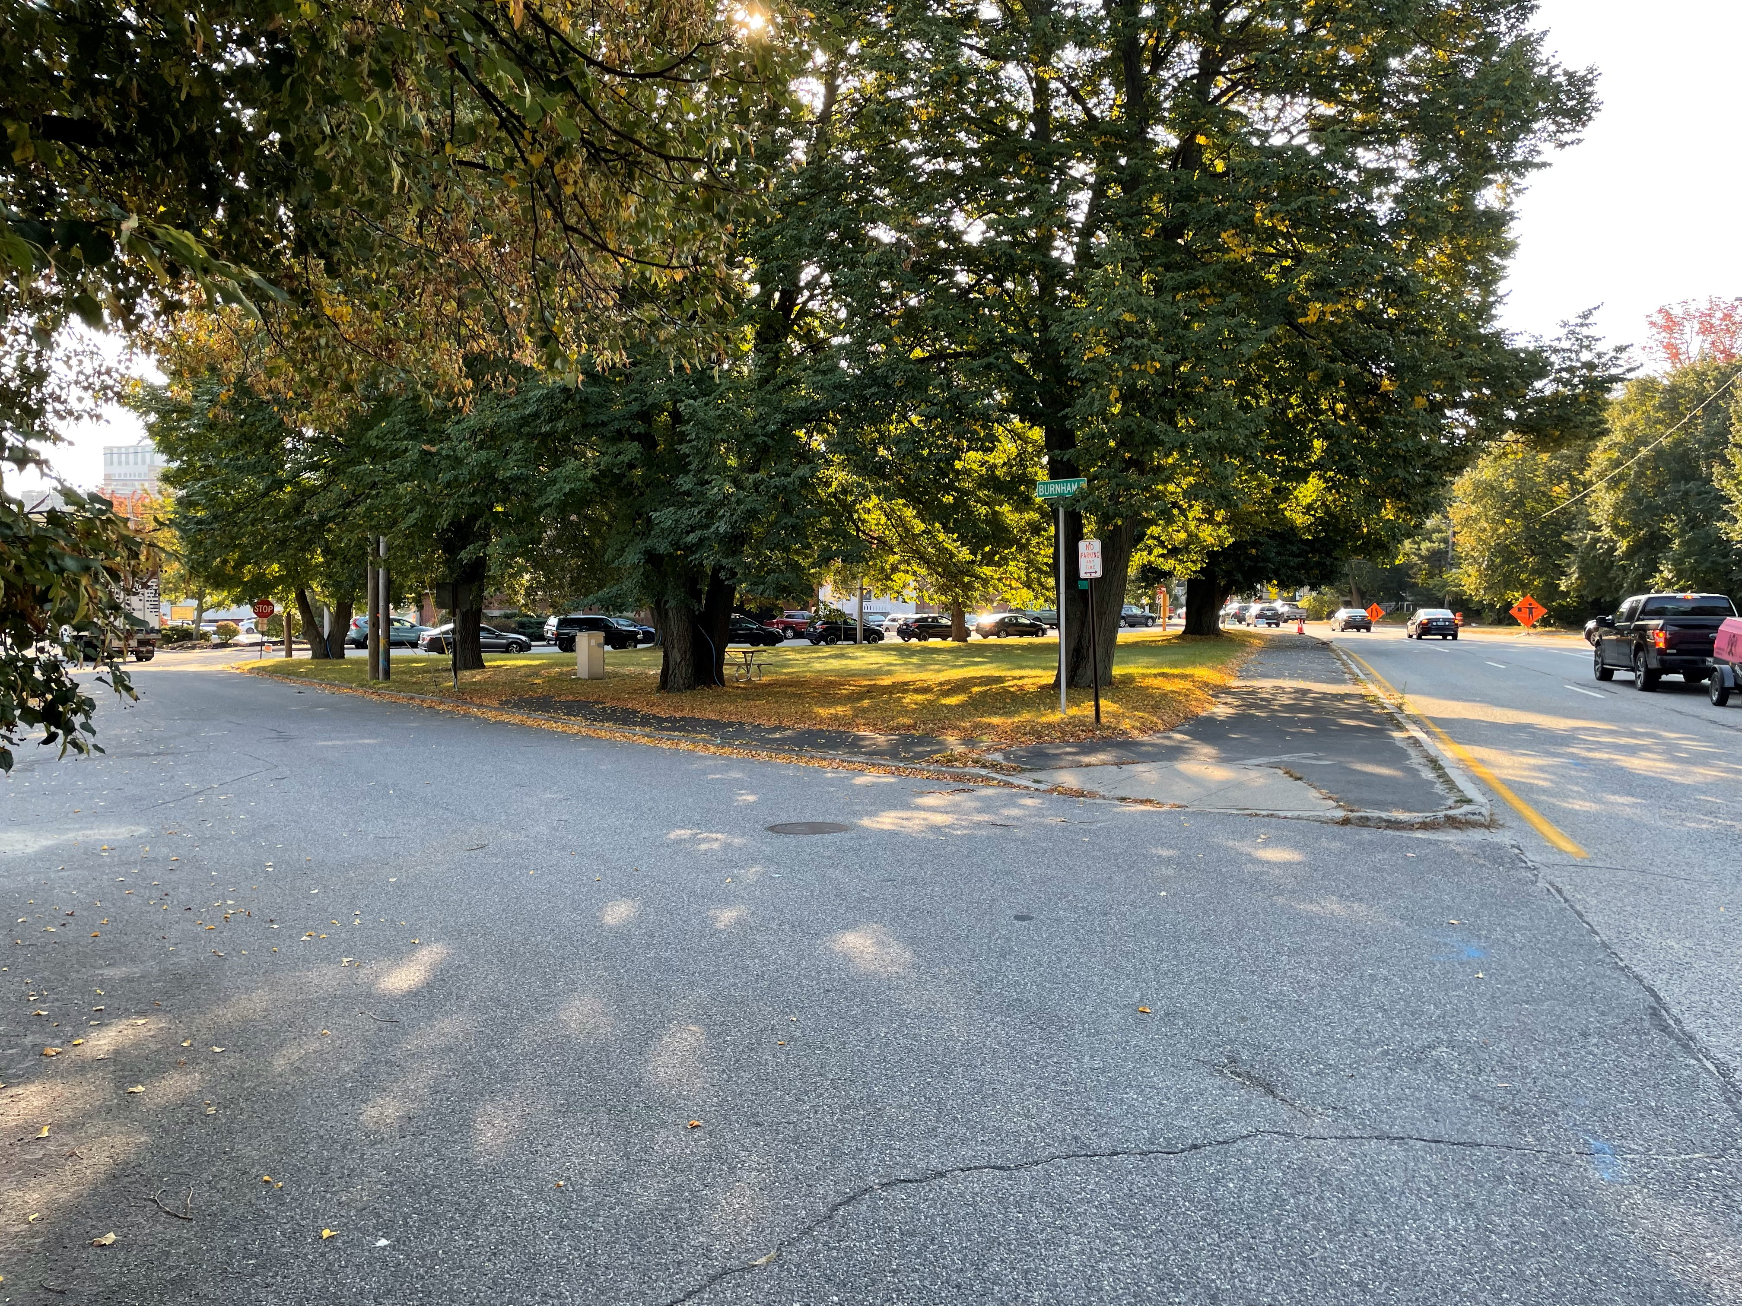
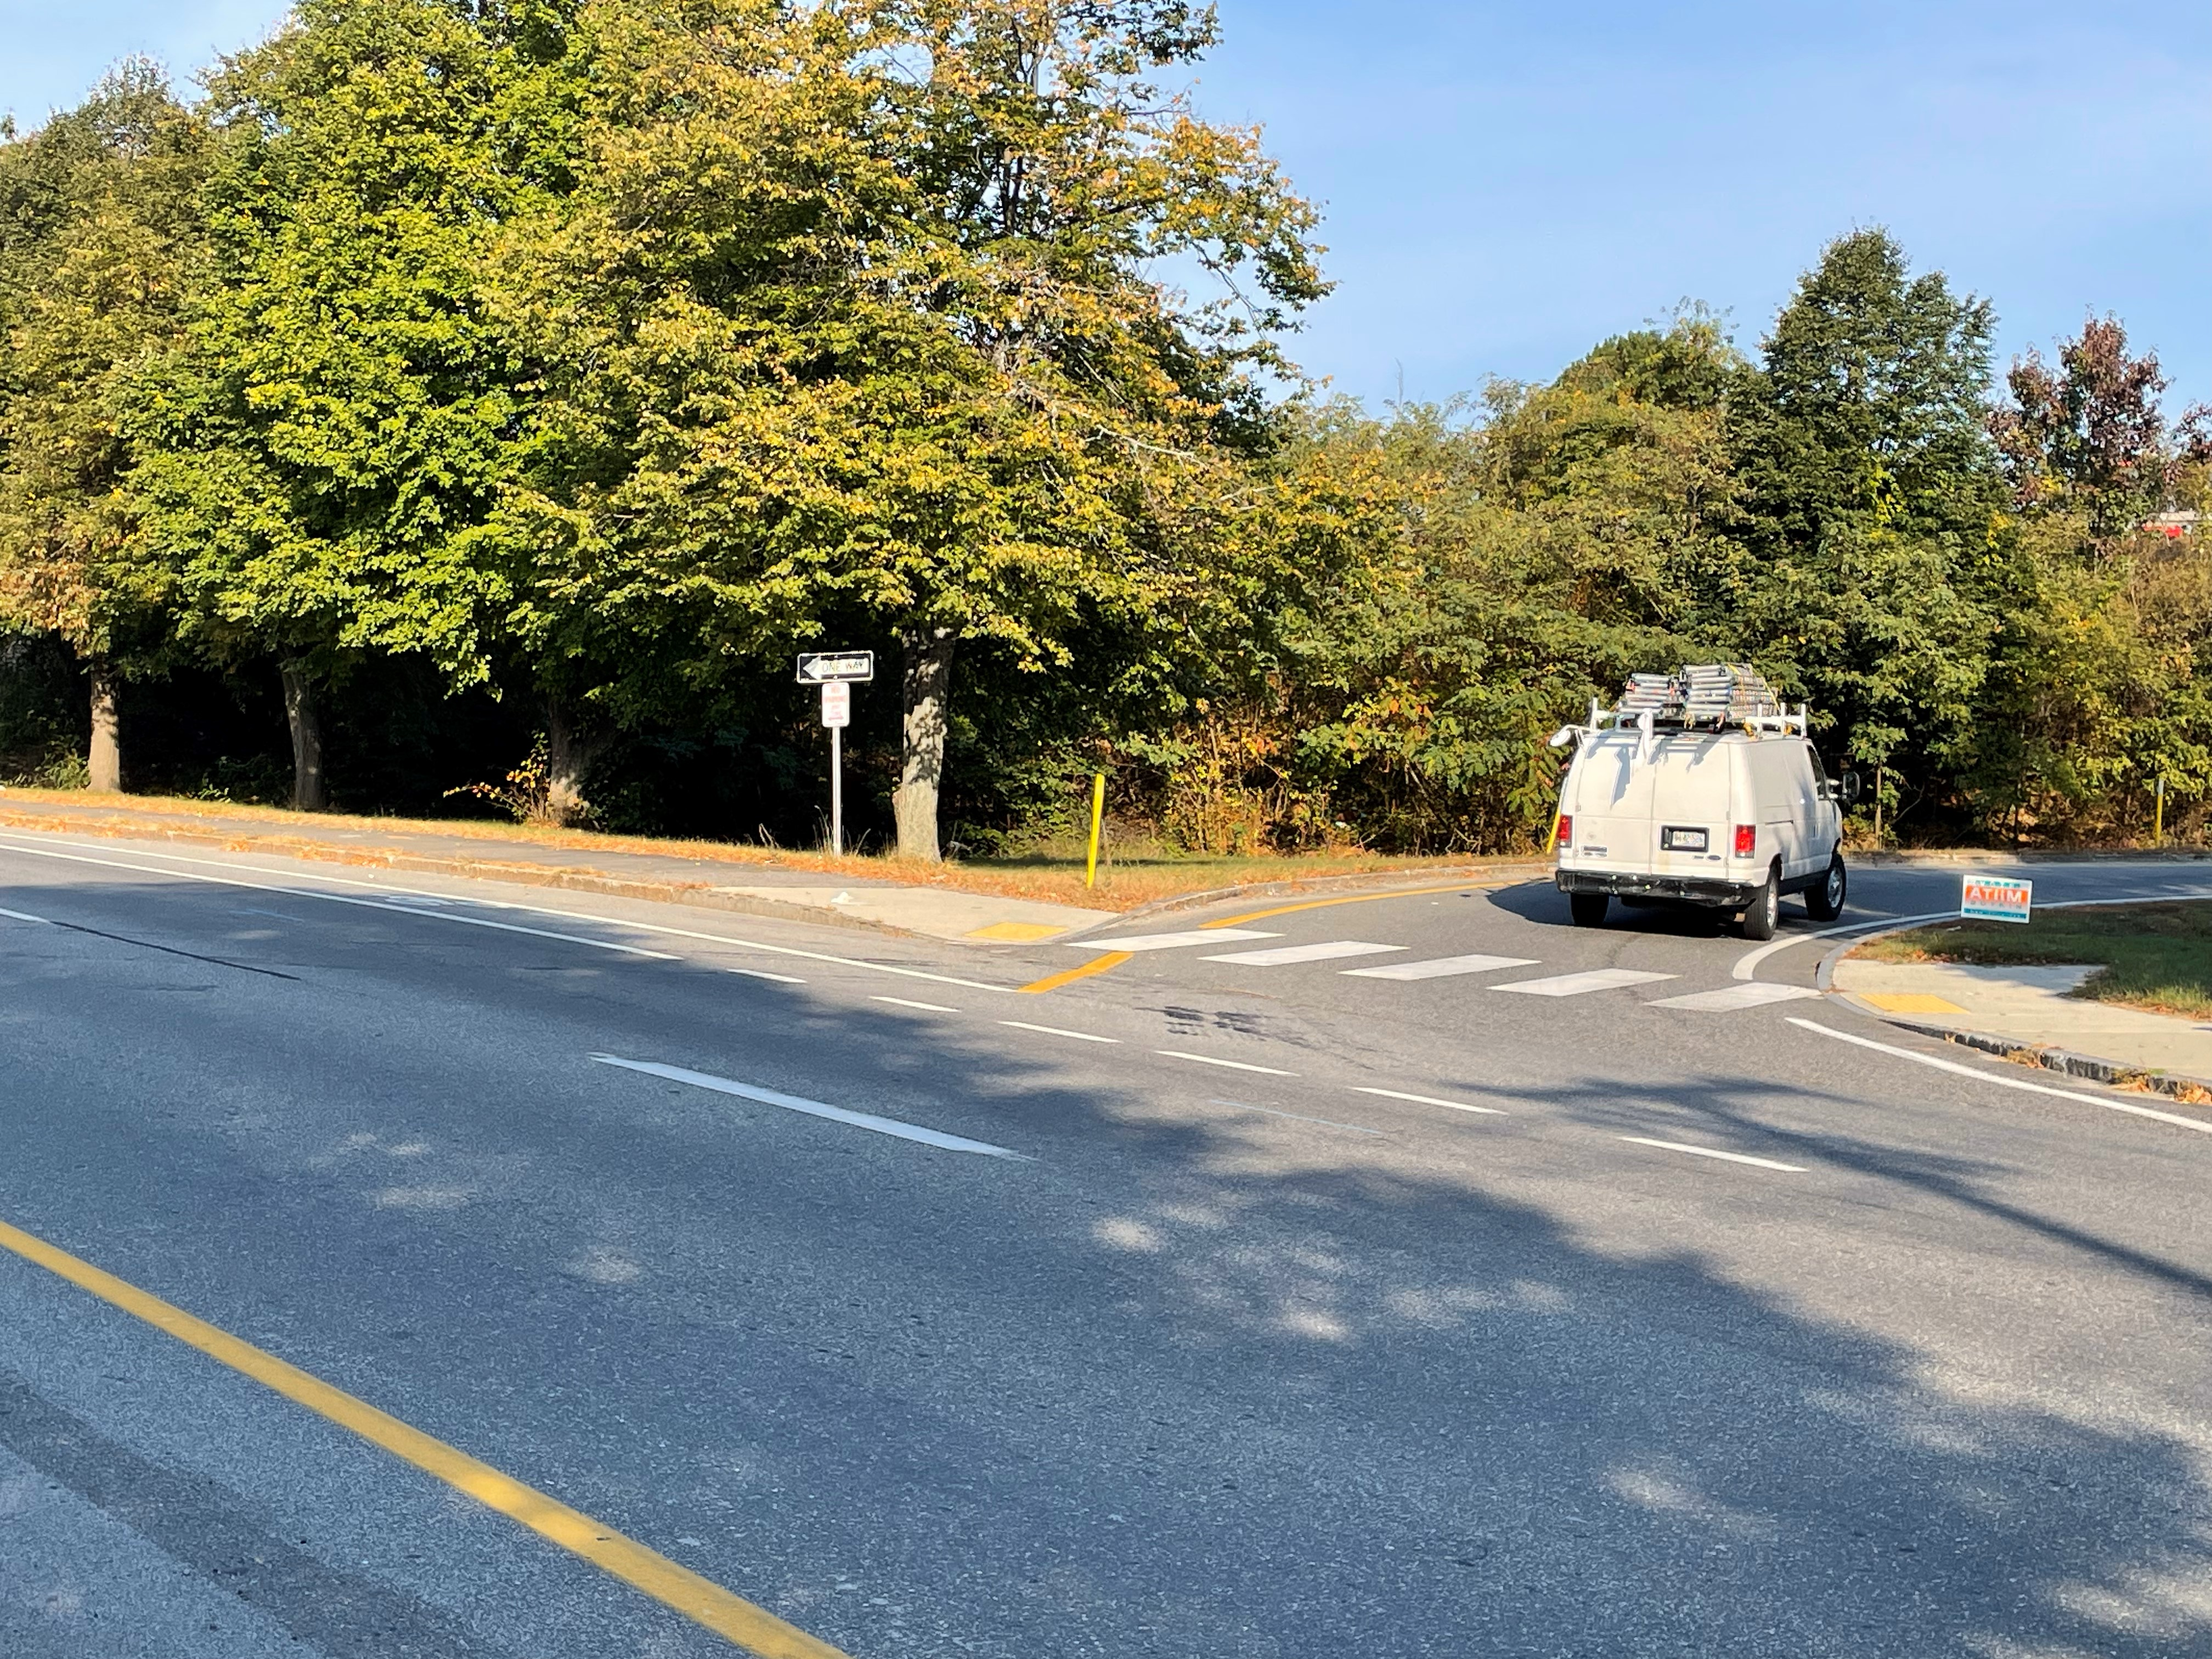
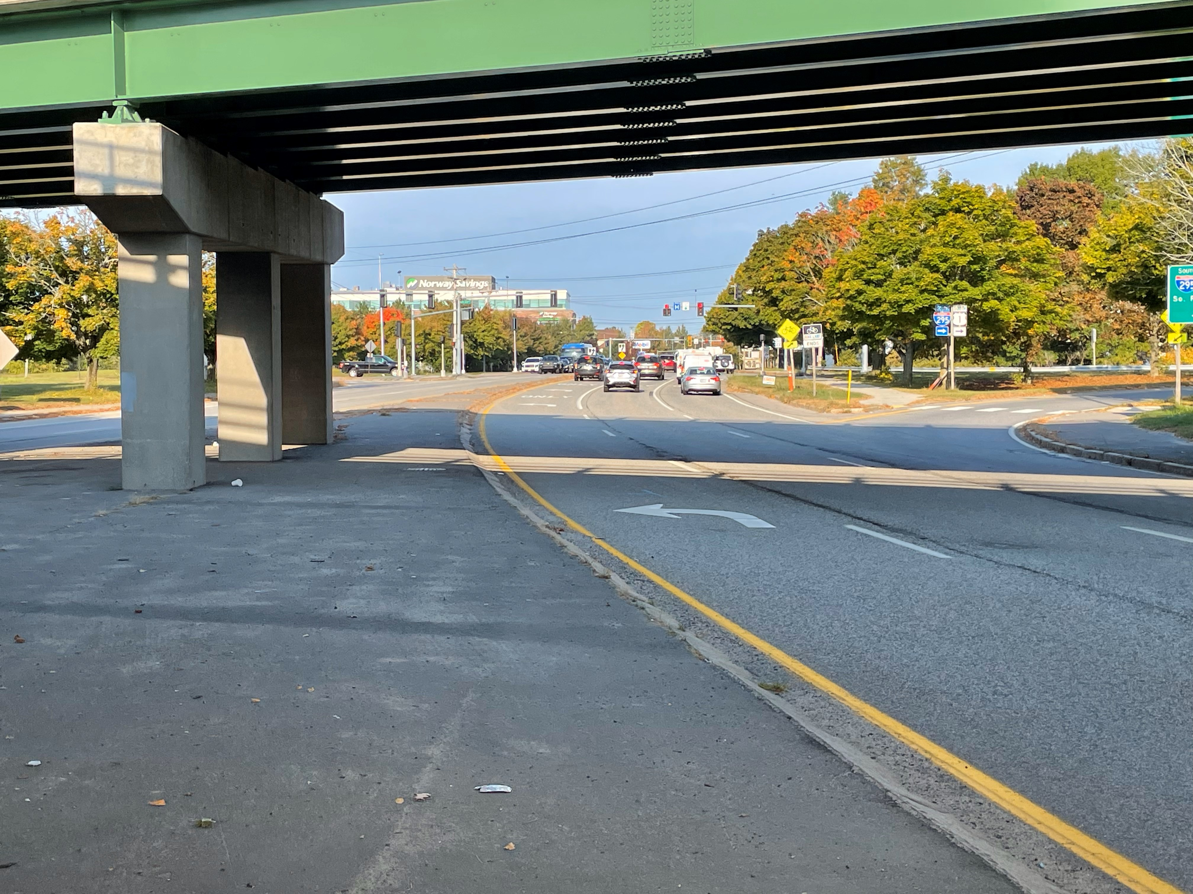
Existing Conditions
Congress St/Lowell St Intersection
Congress St/Burnham St Intersection
I-295 North On-Ramp from Park Ave
I-295 South On-Ramp from Park Ave

Slide 6
Purpose & Need of project
Safety
Connectivity
Multi-Modal Accessibility
(Pedestrian, Bicycle, Transit, Emergency Vehicle, Automobile)
Speed Management
Preserve Interstate Function & Safety
Place-making / Neighborhood Cohesion

Slide 7
BACKGROUND INFORMATION
Project Initiated by City of Portland / PACTS
2009 Connecting Libbytown – Bicycle and Pedestrian Improvements from Parkside to 1-295 Vicinity
2013 Libbytown Traffic Circulation and Streetscape Study
2018 Update to the 2013 Study
2021City of Portland awarded funding from PACTS for Libbytown Safety and Accessibility Project

Slide 8
BACKGROUND INFORMATION (cont.)
2023 Enhanced Project Scoping Project
Feb 2023 Public Meeting presenting Enhanced Project Scoping Results
2024 Reconnecting Communities and Neighborhoods Grant ($22.4 mil)
2023 to Present – MaineDOT Preliminary Design Project

Slide 9
PROPOSED Design
Congress Street and Park Ave changed from one-way to two-way traffic between former Denny’s Rest. and St John St.
Roundabout introduced near the former Denny’s Restaurant.
A two-way Cycle Track (Bicycles) added to Congress Street.
Two one-way Cycle Tracks added to Park Ave.
Sidewalks retained on both sides of Congress and Park.
Paired Bus Stops added on Congress near Marston.

Slide 10
PROPOSED Design
Upgraded Crosswalks
ADA access
Streetscape Additions throughout the project area
Lighting

Slide 11
DESIGN GOALS
Street Designed for Slower Speeds and Increased Safety
Two-way circulation
Continuous bike facilities
High quality pedestrian facilities
Paired bus stop for better transit access
Safer intersections at interstate ramps
Neighborhood integration and place-making

Slide 12
PROPOSED Design
New Roundabout
Park Ave changed from one-way to two-way traffic
Congress St
Park Ave
I-295
St John St
Congress Street changed from one-way to two-way traffic
Congress St

Slide 13
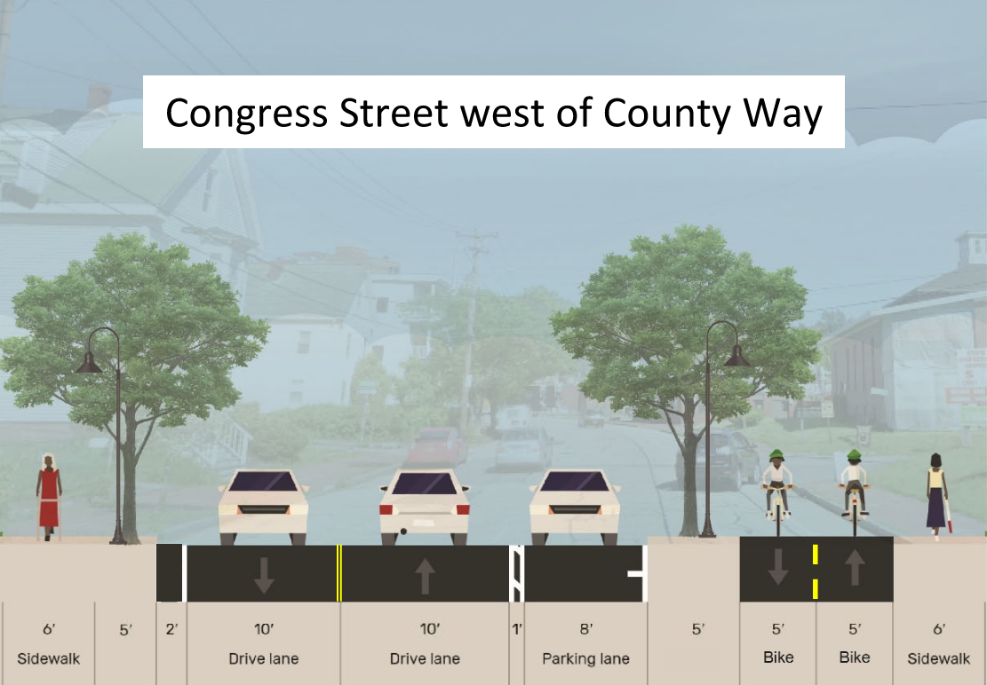
Proposed Typical Sections

Slide 14
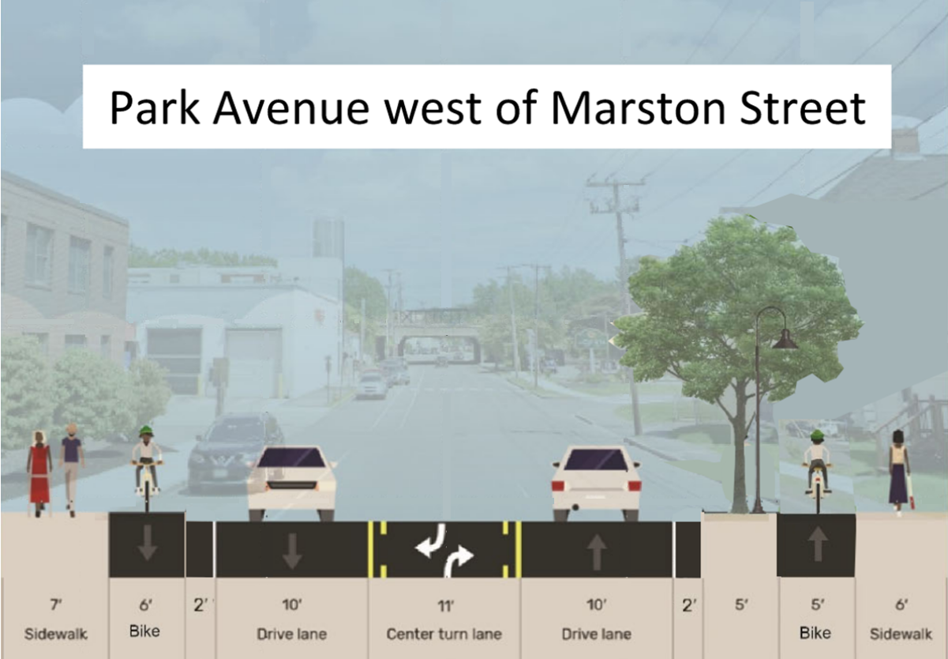
Proposed Typical Sections

Slide 15
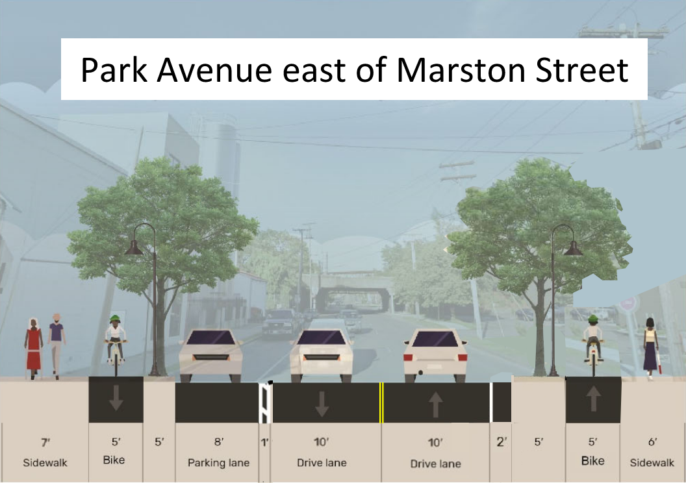
Proposed Typical Sections

Slide 16
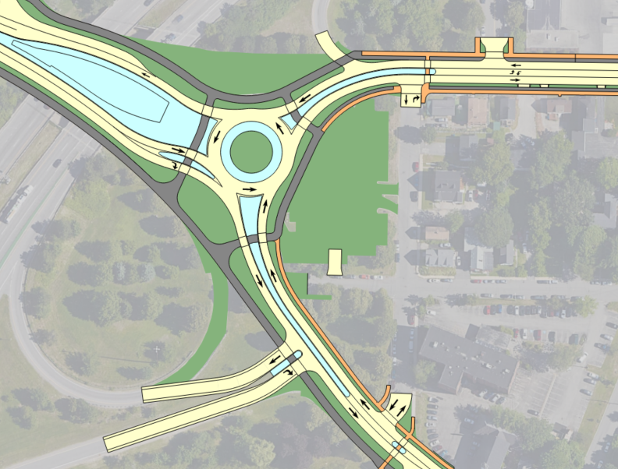
PROPOSED Design
I-295
New Roundabout
Sidewalks
Park Ave
Congress St
Lowell St
Roundabout Location
Bicycle / Pedestrian Path
One-way Cycle Track (Bicycles)
Burnham St
Congress St
I-295 NB On Ramp
Sidewalk
I-295 NB Off Ramp

Slide 17
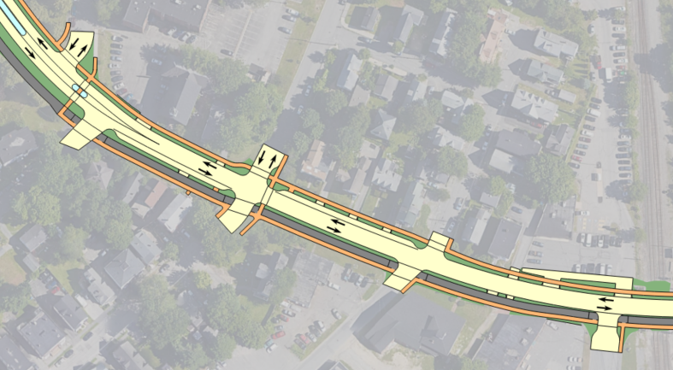
PROPOSED Design
On-Street Parking
Sidewalks on both sides of road
Marston St
Huntress St
Hemlock St
CSX Railroad
Frederic St
Congress St
Westfield St
Bus Stops
Two-way Cycle Track (Bicycle)
Congress Street

Slide 18
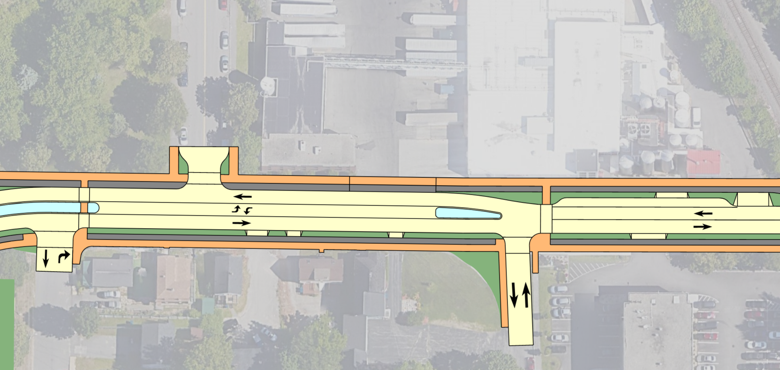
PROPOSED Design
Sidewalks on both sides of road
St. James St
Hood
Park Ave
Lowell St
Center Double Left Turn Lane
Marston St
One-way Cycle Track (Bicycle) on both sides of street
On-Street Parking
Park Avenue

Slide 19
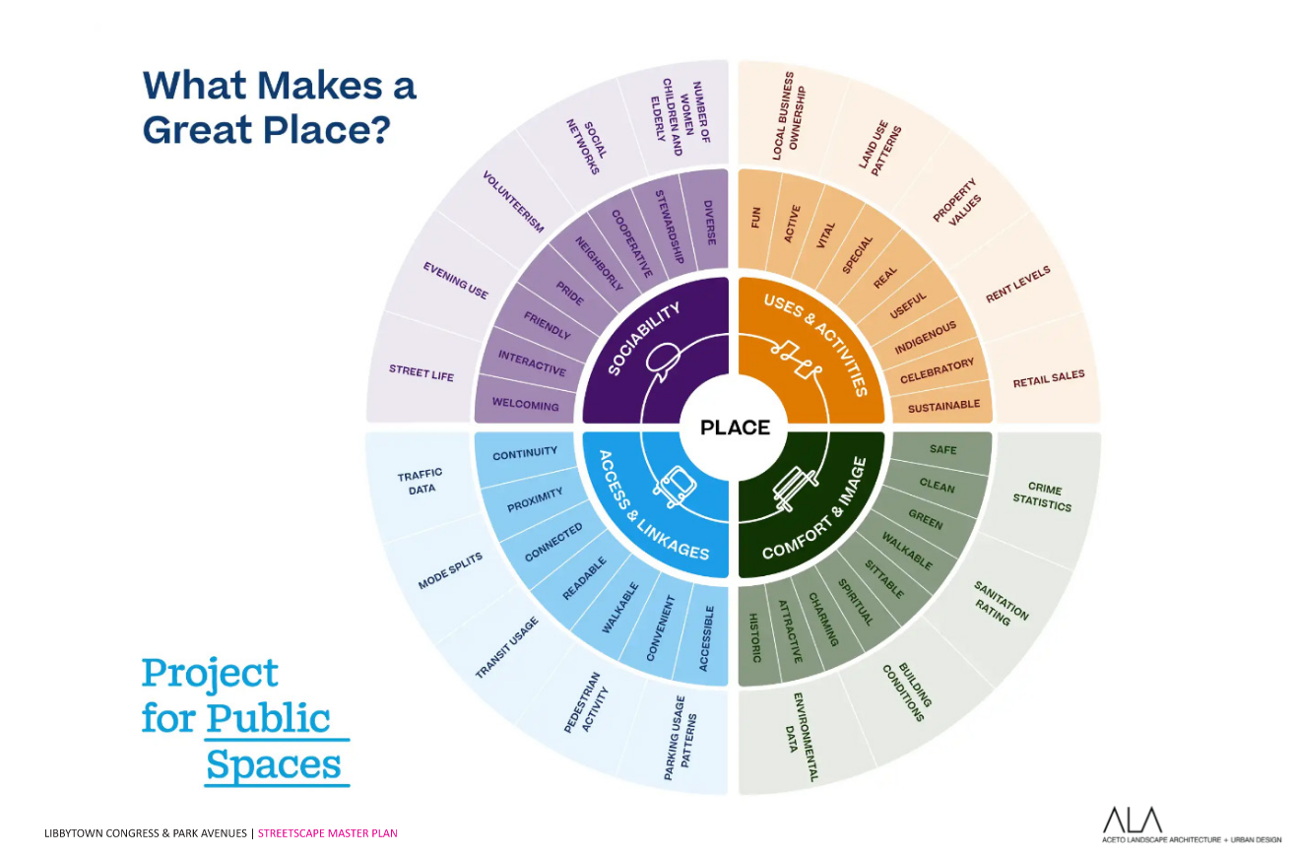
Streetscape concept
St. James St
St. James St
St. James St

Slide 20
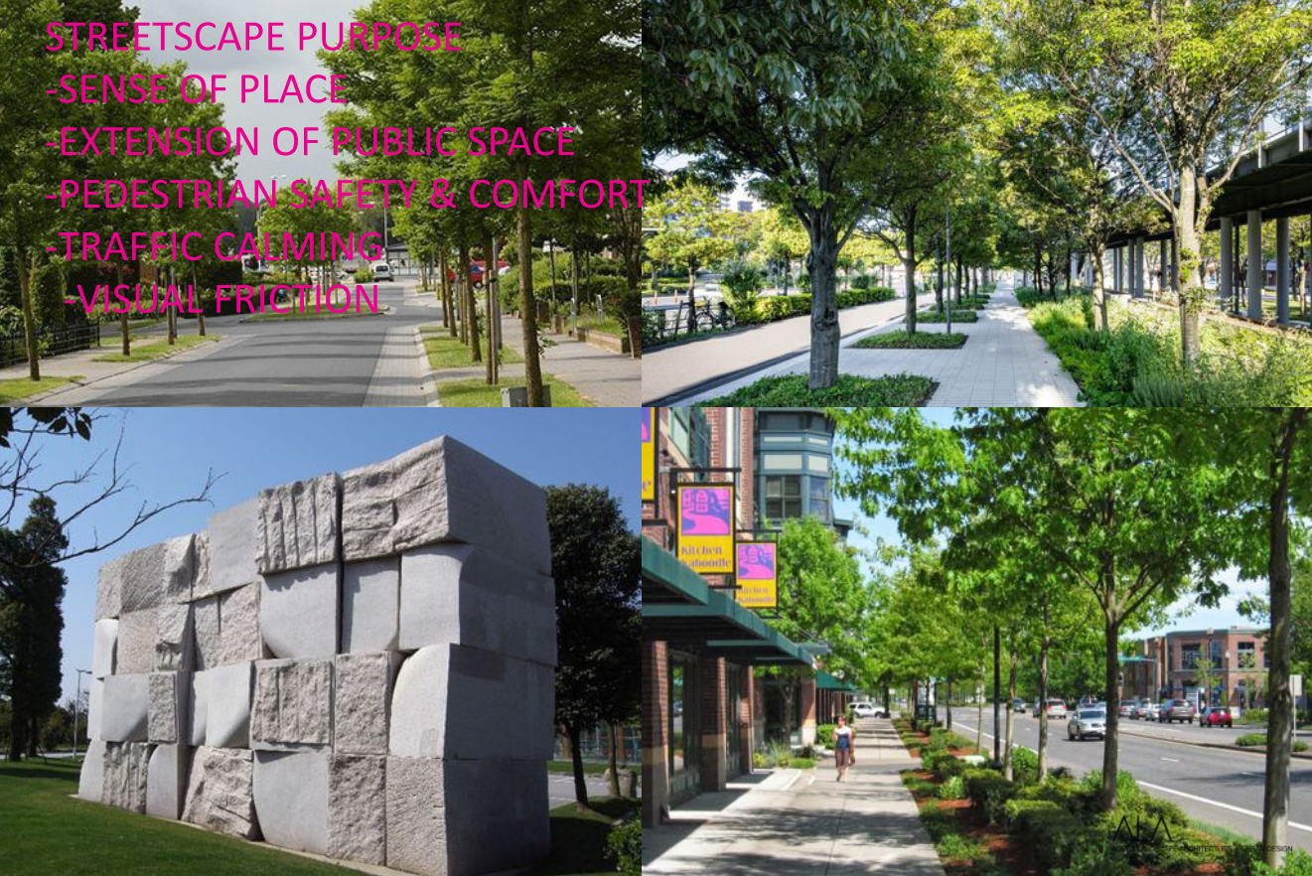
Streetscape concept
St. James St
St. James St
St. James St

Slide 21
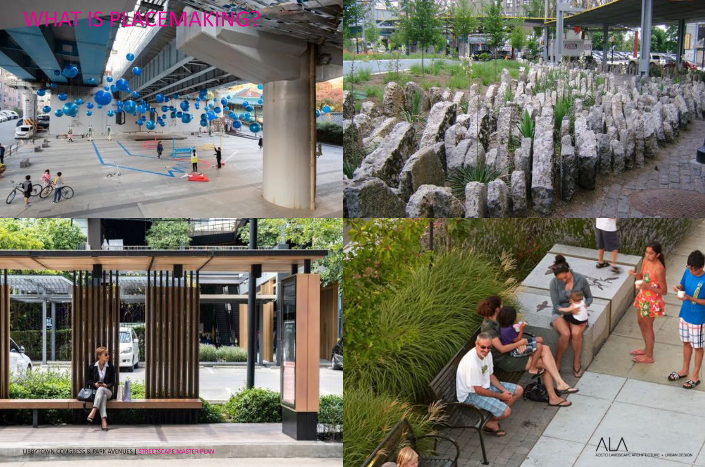
Streetscape concept
St. James St
St. James St
St. James St

Slide 22
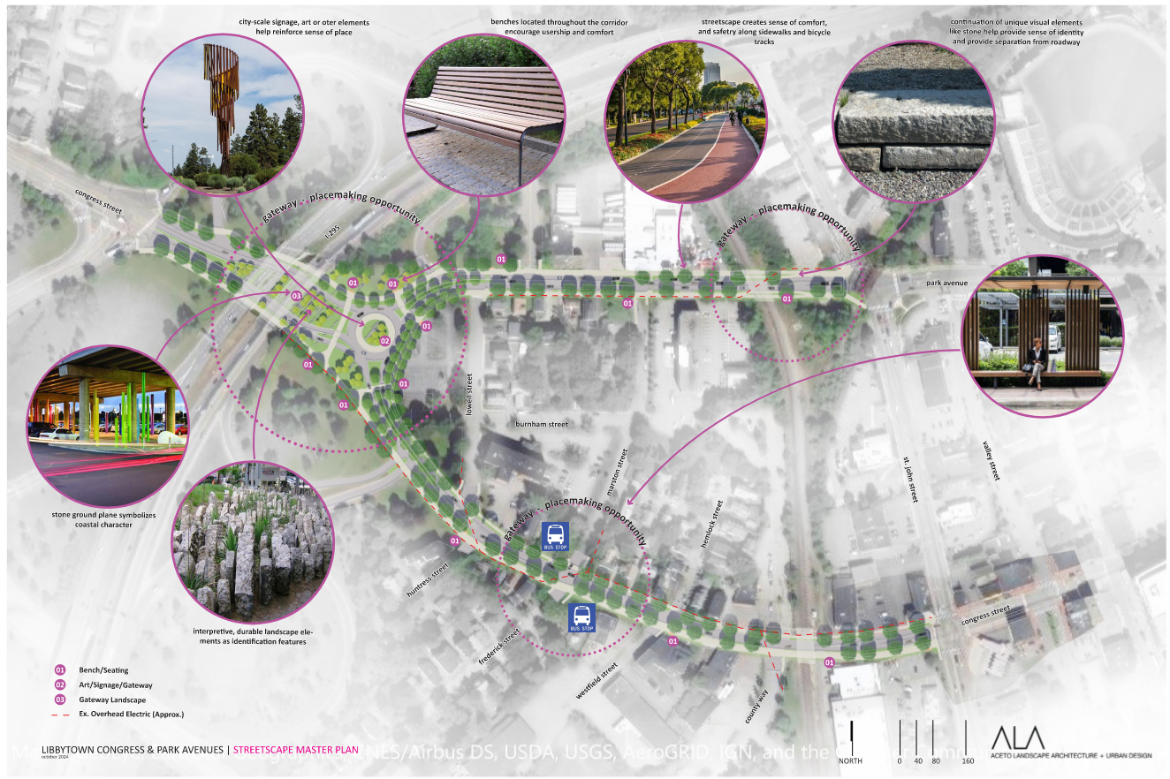
Streetscape concept
St. James St
St. James St
St. James St

Slide 23
Schedule
Concept Design (Began June 2023)
Receive $22.4 million Reconnecting Communities and Neighborhoods Grant
Preliminary Public Meeting
Preliminary Design Recommendations
Final Public Meeting
Final Design
Advertise for Construction (Target Date Fall 2026)
We Are Here

Slide 24
THANK YOU FOR PARTICIPATING
We appreciate you taking the time to review this presentation and encourage you to ask questions or provide comments.
CONTACT
Ernest Martin
MaineDOT
Project Manager
Office – (207) 624-3381
Email – ernest.martin@maine.gov

